Slide 1






Evaluating Media
LT: I can analyze how various sources portray the same issue in order to understand it from different perspectives, as well as to identify bias.

Slide 2






Questions to ask when evaluating:
Where does the money come from
(Who produces it?)?
  ABC is owned by Disney, would they report a negative story about the Disney corporation?
  Who produces the piece may also contribute to the political slant of the piece.

Slide 3
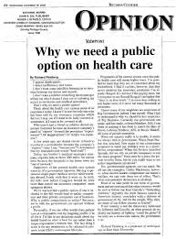


What type of story is it?
  Is it a hard news piece, opinion piece, or a human interest piece?
  Ask yourself, “What is the author’s purpose?”
    Inform, Persuade, Entertain?

Slide 4






What type of sources does it reference?
  Primary Sources vs. Secondary Sources
    Primary Source:Written (or created) in the time of the event under study
    Secondary Source: Written (or created) after the event

Slide 5


What evidence is provided?
  Though very tied to sources, evidence needs to be identified to examine the quality of it.
    Is the evidence verified through other sources?
    Does it come from a primary source or a secondary source?
    “Scientists agree” vs. “25 Scientists agree”

Slide 6
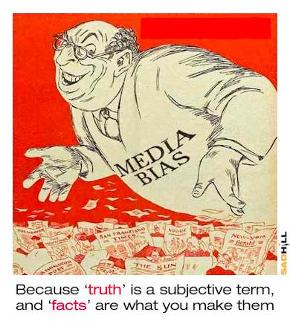
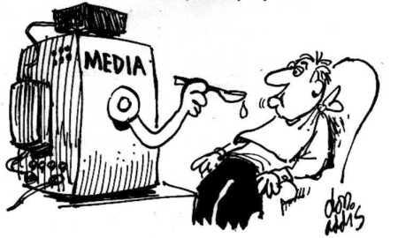
What types of bias may be present?
  Omission
  Source Selection
  Story Selection
  Placement
  Labeling
  Spin

Slide 7
YOUR TASK:
Choose a current event (local, national, or global) with the purpose of evaluating the way it is presented in media. You will then create a short presentation that synthesizes your findings and evaluates the media’s coverage of the event.
Requirements:
Must be current
Presentation 3-5 minutes
Analyze at least two media stations/papers
Visual Aid

